Slide 1

Team Details:
Team Name: Tribalag
Team Leader Name: Ankika Giri
Problem Statement: Tech Solutions Making Regenerative Agriculture Remunerative

Slide 2
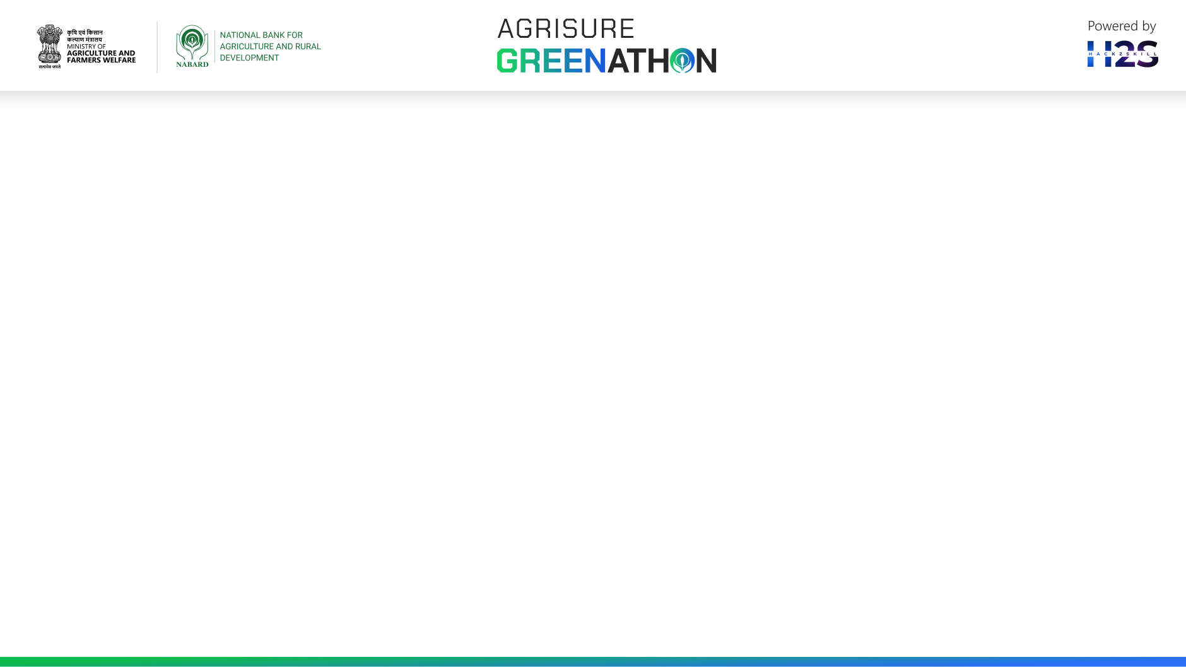
Project Title:
Fruit Tree Planting Lifecycle Management Solution
Objective: Develop an IT-enabled platform to manage fruit tree planting, provide additional income to farmers, and alleviate climate change impacts.
Key Features:
- Farmer Portal:
- Vriksha Sevak Portal:
- Administrative Portal:
- Maps:

Slide 3
Goals:
- Support farmers in managing fruit tree planting and earning a steady income
- Alleviate climate change impacts through carbon credit ecosystem
- Scale up the project to tribal districts in Jharkhand, Sikkim, and West Bengal
Current System:
- Manual process with Vriksha Sevak supporting farmers in each cluster
- Data collection, sapling distribution, and fruit marketing done manually
Proposed System:
- IT-enabled platform for efficient management and tracking
- Three portals for farmers, Vriksha Sevak, and administrators
- Maps and geo-tagging for location tracking

Slide 4
Opportunities
How different is it from any of the other existing ideas?
1. Tribal District Focus:
2. Comprehensive Lifecycle Management:
3. Multilingual Support:
4. Integration with State-Level Support:
5. Carbon Credit Ecosystem:
6. Aggregation Power:
7. Phased Implementation:

Slide 5
How will it be able to solve the problem?
1. Predictable income streams
2. Access to expertise and resources
3. Efficient supply chain management
4. Climate change mitigation strategies
5. User-friendly and inclusive platform

Slide 6
USP of the proposed solution
Comprehensive Lifecycle Management: End-to-end support for farmers, from planting to harvesting and selling
Multilingual Support: Personalized voice calls and platform support in local languages, ensuring inclusivity
Carbon Credit Ecosystem: - Additional revenue stream for farmers through carbon credits, promoting sustainable practices
Integration with State-Level Benefits: Streamlined access to subsidies, benefits, and resources for farmers
Geo-Tagging and Monitoring: Real-time tracking of plant health, enabling data-driven decisions
Aggregation Power: - Connecting farmers with relevant players in the supply chain, amplifying their collective impact
Phased Implementation: - Iterative approach ensuring successful adoption and scaling up

Slide 7
List of features offered by the solution
Farmer Portal
1. Registration and profiling
2. Demand assessment and capture
3. Personalized voice calls for planting and nurturing guidance
4. Access to weather reports and agro-advisory services
5. Input ordering and management
6. Fruit sales management and market linkage
7. Carbon credit benefits and tracking

Slide 8
Vriksha Sevak Portal
1. Farmer data management and tracking
2. Sapling distribution and management
3. Plant health monitoring and reporting
4. Geo-tagging and mapping of plant locations
5. Truck movement tracking and logistics management

Slide 9
Administrative Portal
1. Overall project monitoring and management
2. Marketing and sales management
3. State-level benefit and subsidy management
4. Carbon credit management and tracking
5. Reporting and analytics dashboard

Slide 10
Other Features
1. Multilingual support for farmers
2. Integration with state-level benefits and subsidies
3. Aggregation power for farmers to connect with supply chain players
4. Phased implementation for successful adoption and scaling up

Slide 11
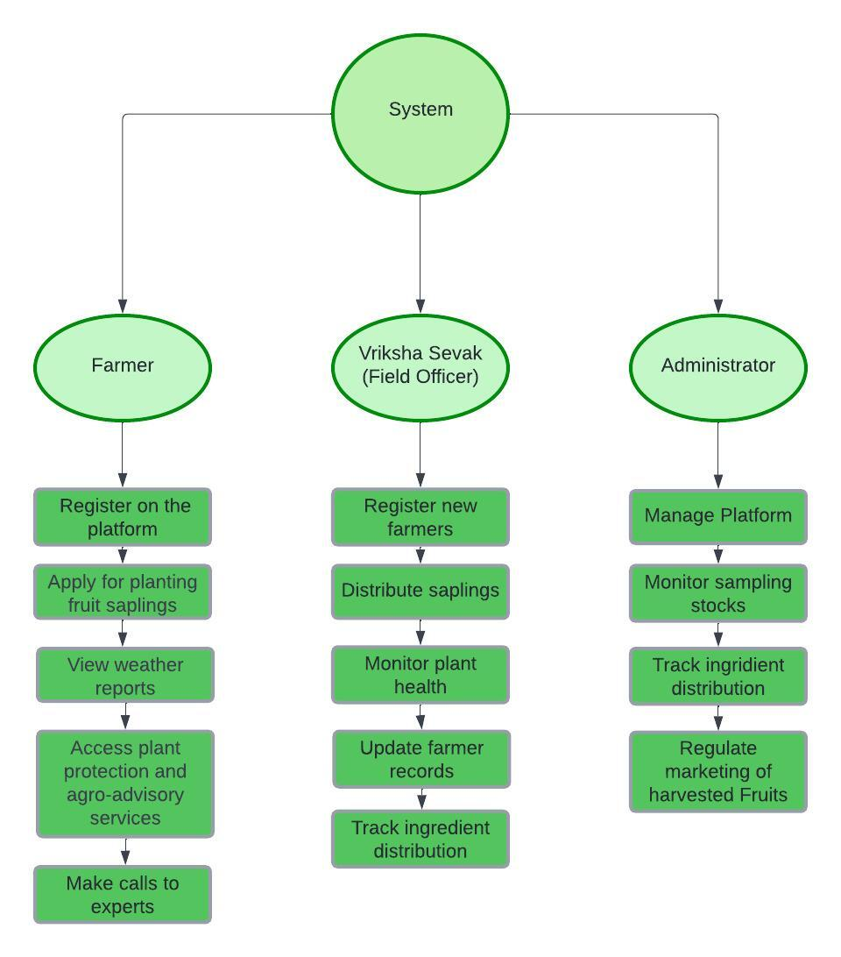
Process flow diagram or Use-case diagram

Slide 12
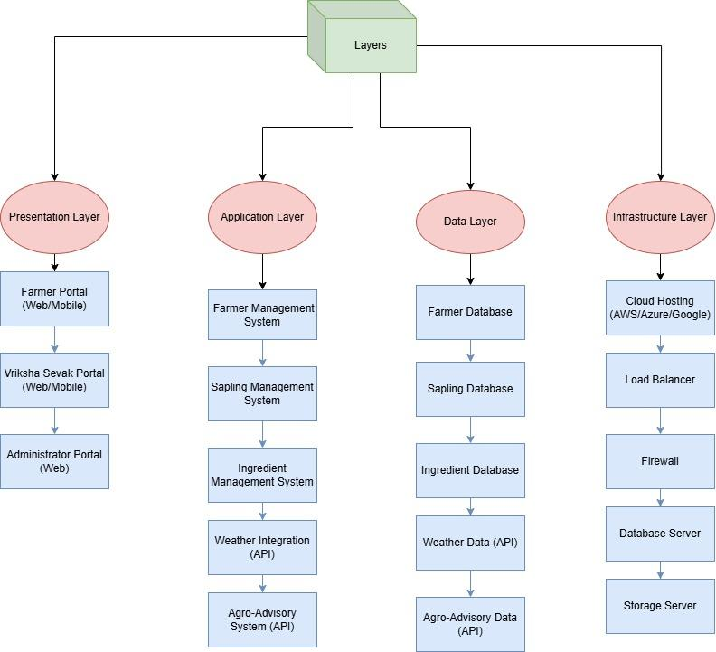
Architecture diagram of the proposed solution

Slide 13
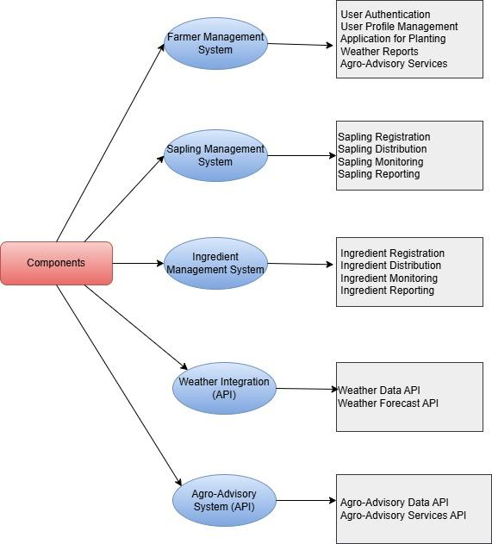
Architecture diagram of the proposed solution

Slide 14
Technologies to be used in the solution
Frontend:
1. React for building the user interface and user experience.
2. CSS frameworks like Bootstrap for styling and layout.
Backend:
1. Node.js with Express.js for building the server-side logic.
2. Database: MongoDB for storing user data and application settings.
3. Authentication: JSON Web Tokens (JWT) for secure authentication.

Slide 15


